Slide 1
Team D - Research Presentation
Our findings on Python

Slide 2
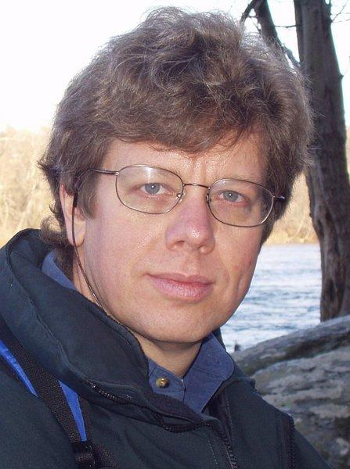
Guido van Rossum
Wanted a higher level language to develop administrative utilities for Amoeba OS
C took too long, and Bourne shell was not feasible
Python was Born
His Beard

Slide 3
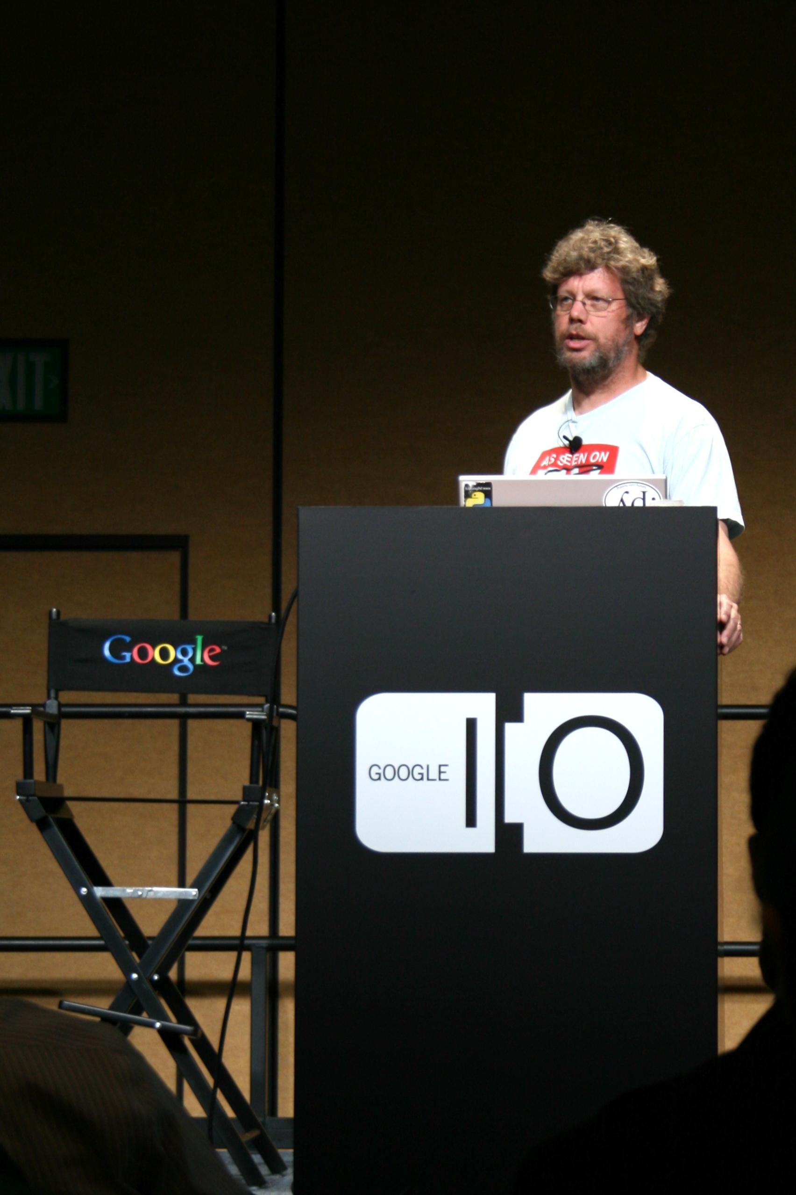

Slide 4
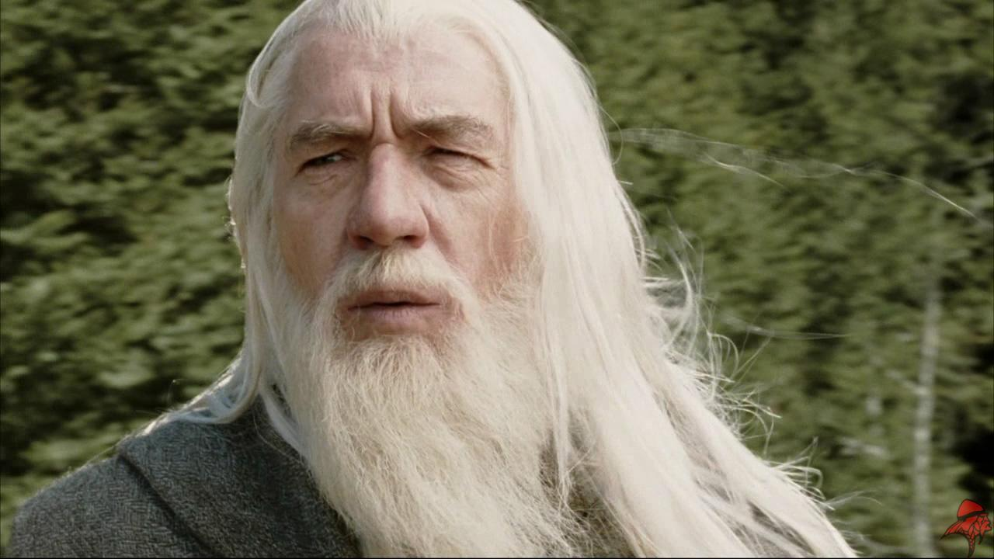

Slide 5
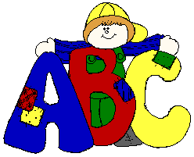
ABC and Python
Python is ABC’s Child
Typing: Static vs. Dynamic
Concatenating Strings or Adding Ints
Data Types

Slide 6
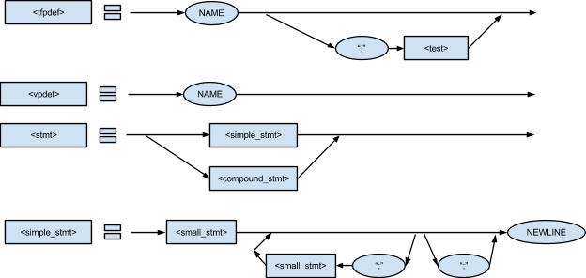
BNF Grammer
Notes:
Explain that our team spent close to 6 hours creating the rail diagrams. This is one example

Slide 7
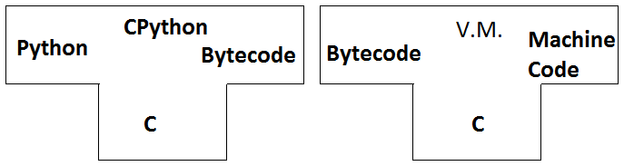
Development Toolchain
Is traditionally compiled with a bytecode interpreter
CPython was the first compiler, which was written in C
Notes:
Assuming that C is running on the computer, we have

Slide 8
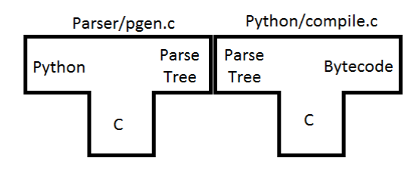
Pre 2.4 CPython

Slide 9
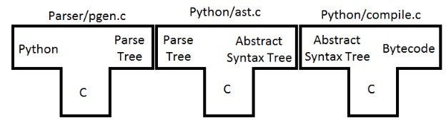
Post 2.4 CPython

Slide 10
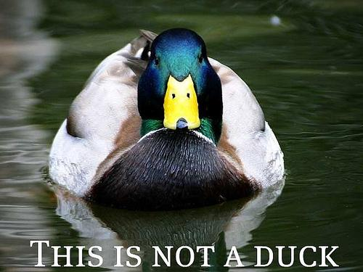
Type Inferencing
Dynamically Typed - Hard to Infer
PyPy byproduct rPython could allow Inference
Python Lists Complicate Everything
“Duck” Typing

Slide 11
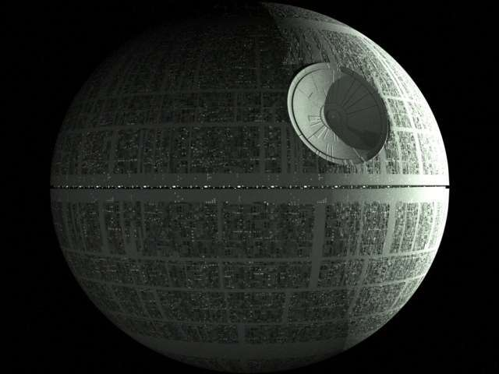
More Inference
Atomic Types vs. Classes and Atomic Container Constructs
UVic Researcher comes up with ATI
Cool Names Psyco, StarKiller

Slide 12
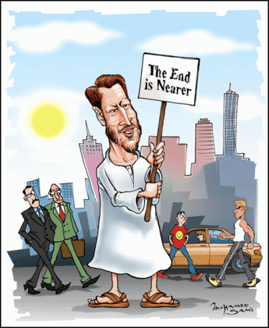
Questions

